Slide 1
Web Technologies
Web Basics

Slide 2
Summary of Today’s Lecture
Web Terminologies
Hypertext Transfer Protocol (HTTP)
Uniform Resource Locator (URL)
World Wide Web (WWW)
Evolution of Web
World Wide Web (W3C) Consortium

Slide 3
Web Terminologies
Internet
A global computer network, consisting of interconnected networks using standardized communication protocols.
Hyperlink
In computing, a hyperlink, or simply a link, is a reference to data that the reader can directly follow by clicking.
World Wide Web
The World Wide Web (WWW) is a system of interlinked hypertext documents accessed via the Internet. It is an information space where documents and other web resources are identified by Uniform Resource Locators (URLs).

Slide 4

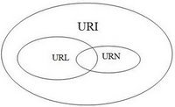
Web Terminologies
URN:
URN stands for Uniform Resource Name and it identifies a resource by name in a given namespace. A namespace refers a group of names or identifiers.
URL:
URL stands for Uniform Resource Locator and it defines the network location of a specific resource. A resource, or a web resource refers to anything ranging from documents, files, images, web pages, etc that can be part of the web architecture.
URI:
URI stands for Uniform Resource Identifier and it uniquely identifies a resource over the Web.
https://prateekvjoshi.com/2014/02/22/url-vs-uri-vs-urn/

Slide 5
Web Terminologies
HTTP
Short for Hyper Text Transfer Protocol, the underlying protocol used by the World Wide Web. HTTP defines how messages are formatted and transmitted, and what actions Web servers and browsers should take in response to various commands.
HTML
Short for HyperText Markup Language, the authoring language used to create documents on the World Wide Web.
Markup Language is like a blueprint or layout for the processing and appearance of text documents. In HTML, tags are used to specify the layout or the way to subsequent line must appear.
Web page
A document on the WWW. Every web page is identified by a unique URL.

Slide 6
Web Terminologies
Website
A website is a collection of related web pages, including multimedia content, typically identified with a common domain name. Each site is owned and managed by an individual, company or organization.
Home page
The main page of a Web site. Typically, the home page serves as an index or table of contents to other documents stored at the site.
Browser
Short for Web browser, a software application used to locate and display Web sites.

Slide 7
Hypertext Transfer Protocol
HTTP is a transaction-oriented client/server protocol.
HTTP is a stateless protocol and creates a TCP connection for each transaction (e.g. download a page).
A stateless protocol is a communications protocol that treats each request as an independent transaction that is unrelated to any previous request.
Each transaction is treated separately so that the communication consists of independent pairs of requests and responses.
An HTTP server has no knowledge of which web pages (if any) a client has accessed previously.
If a web server needs to store a client's state, it can store cookies in the client’s web browser (cookies are not part of http).
For more information, visit https://www3.ntu.edu.sg/home/ehchua/programming/webprogramming/HTTP_Basics.html

Slide 8
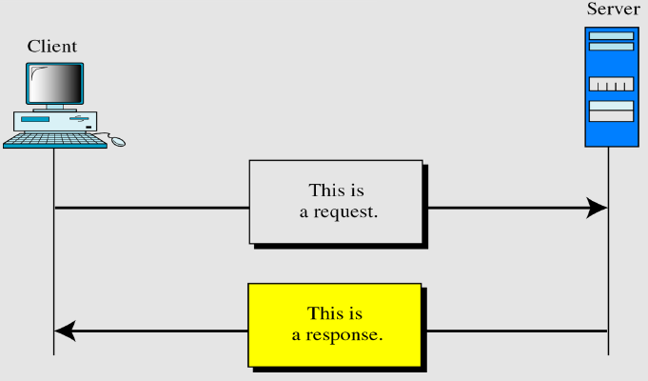
HTTP Transaction

Slide 9
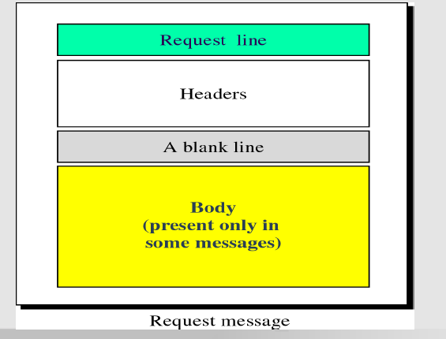
Http Request Message

Slide 10
Http Request Message
HTTP request to fetch hello.htm page from the web server running on tutorialspoint.com.
GET /hello.htm HTTP/1.1
User-Agent: Mozilla/4.0 (compatible; MSIE5.01; Windows NT)
Host: www.tutorialspoint.com
Accept-Language: en-us
(blank line)

Slide 11
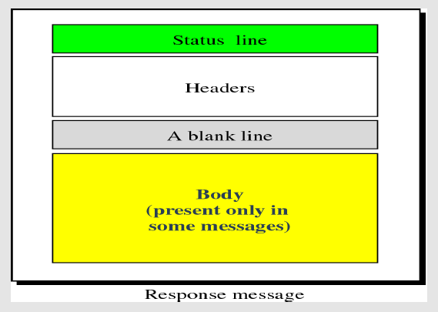
Http Response Message

Slide 12
Http Response Message
HTTP/1.1 200 OK
Date: Mon, 27 Jul 2009 12:28:53 GMT
Server: Apache/2.2.14 (Win32)
Content-Type: text/html
Connection: Closed
(blank line)
<html>
<body>
<h1>Hello, World!</h1>
</body>
</html>

Slide 13
Http Request/ Response Message
Request Message
GET /hello.htm HTTP/1.1
User-Agent: Mozilla/4.0 (compatible; MSIE5.01; Windows NT)
Host: www.tutorialspoint.com
Accept-Language: en-us
(blank line)
Response Message
HTTP/1.1 200 OK
Date: Mon, 27 Jul 2009 12:28:53 GMT
Server: Apache/2.2.14 (Win32)
Last-Modified: Wed, 22 Jul 2009 19:15:56 GMT
Content-Length: 88
Content-Type: text/html
Connection: Closed
(blank line)
<html>
<body>
<h1>Hello, World!</h1>
</body>
</html>

Slide 14
Request/ Response Example
HTTP request to fetch t.html page that does not exist on the web server running on tutorialspoint.com.
Request Message
GET /t.html HTTP/1.1
User-Agent: Mozilla/4.0 (compatible; MSIE5.01; Windows NT)
Host: www.tutorialspoint.com
Accept-Language: en-us
Accept-Encoding: gzip, deflate
Response Message
HTTP/1.1 404 Not Found
Date: Sun, 18 Oct 2012 10:36:20 GMT
Server: Apache/2.2.14 (Win32)
Content-Length: 230
Content-Type: text/html;
Connection: Closed
<html>
<head>
<title>404 Not Found</title>
</head>
<body>
<h1>Not Found</h1>
<p>The requested URL /t.html was not found on this server.</p>
</body> </html>

Slide 15
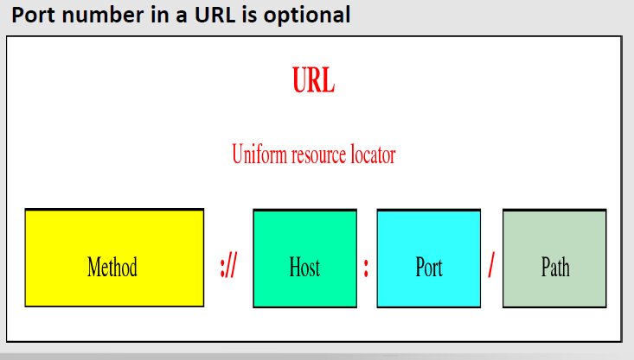
Method: The application-level protocol used by the client and server, e.g., HTTP, FTP, and telnet. Host: The DNS domain name (e.g., www.nowhere123.com) or IP address (e.g., 192.128.1.2) of the server. Port: The TCP port number that the server is listening for incoming requests from the clients. Path: The name and location of the requested resource, under the server document base directory.
Uniform Resource Locator

Slide 16
World Wide Web
The World Wide Web (abbreviated as WWW or W3 and commonly known as the Web) is a system of interlinked hypertext documents accessed via the Internet.
With a web browser, one can view web pages that may contain text, images, videos, and other multimedia and navigate between them via hyperlinks.
Using concepts from earlier hypertext systems, British engineer and computer scientist Sir Tim Berners-Lee, now Director of the W3C has invented WWW.

Slide 17
World Wide Web
The key feature of this was Tim Berners-Lee’s invention of the hypertext link, an embedded one-way pointer to another location
This location could be another point within the same document, another document, a different resource such as an image or sound file,
these could be on the local server, or some server anywhere in the world.
These documents are viewed with a browser such as Firefox, Opera, Microsoft Internet Explorer, and Google Chrome.

Slide 18
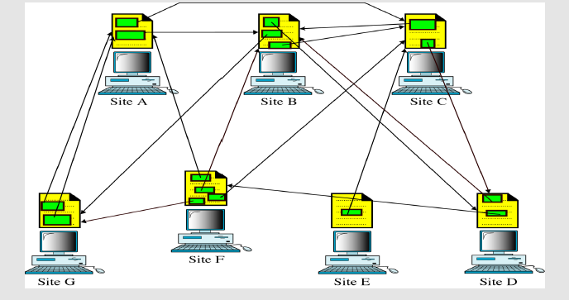
Distributed hypertext (Web)
Diagram shows how linked hypertext documents may reside

Slide 19
Evolution of Web
Web 1.0 – That era was all about read-only content and static HTML websites.
Web 2.0 – This is about user-generated content and the read-write web. People are consuming as well as contributing information through blogs or sites like Flickr, YouTube, Digg, etc. The line dividing a consumer and content publisher is increasingly getting blurred in the Web 2.0 era.
Web 3.0 – This is about semantic web (or the meaning of data), intelligent search and behavioral advertising among other things & most of all collective intelligence.

Slide 20
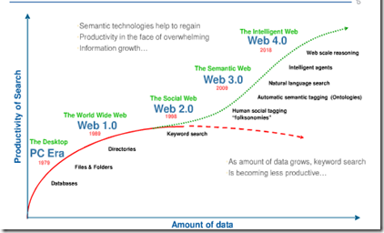
Evolution of the Web

Slide 21
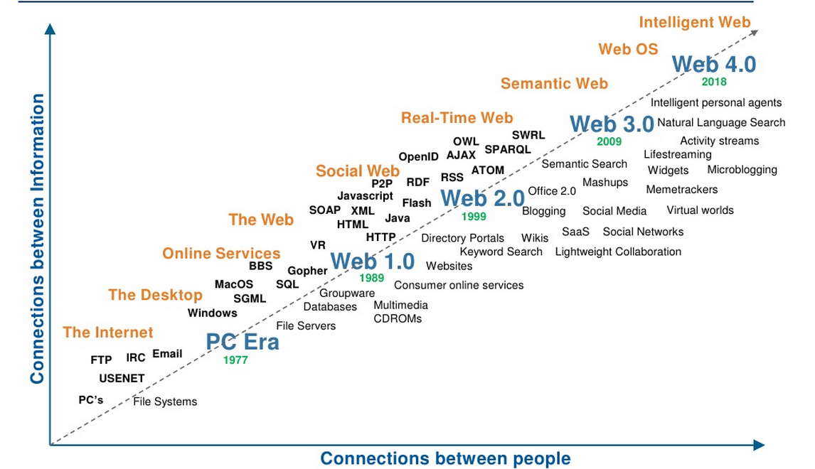
Evolution of the Web

Slide 22
Web Standards
The World Wide Web Consortium (W3C) is an international community that develops open standards to ensure the long-term growth of the Web.
Founded in 1994 by Sir Tim Berners-Lee (inventor of the Web)
W3C is the home of the Web and Semantic Web (http://www.w3.org)
400+ members (the usual suspects, SMEs, users,...) (http://www.w3.org/Consortium/Member/List)
Invited experts and volunteers

Slide 23
Design Principles
Web for Everyone
One of W3C's primary goals is to make these benefits available to all people, whatever their native language, culture, geographical location, or physical or mental ability.
Web on Everything
The number of different kinds of devices that can access the Web has grown immensely. Mobile phones, smart phones, personal digital assistants, interactive television systems, voice response systems, kiosks and even certain domestic appliances can all access the Web.

Slide 24
References
https://flatworldbusiness.wordpress.com/flat-education/previously/web-1-0-vs-web-2-0-vs-web-3-0-a-bird-eye-on-the-definition/
https://www.business2community.com/tech-gadgets/eras-of-the-web-web-0-0-through-web-5-0-02239654
https://www.researchgate.net/publication/321366810_Concept_and_Dimensions_of_Web_40
https://www.w3.org/
https://www.w3.org/WAI/fundamentals/accessibility-intro/

